Slide 1
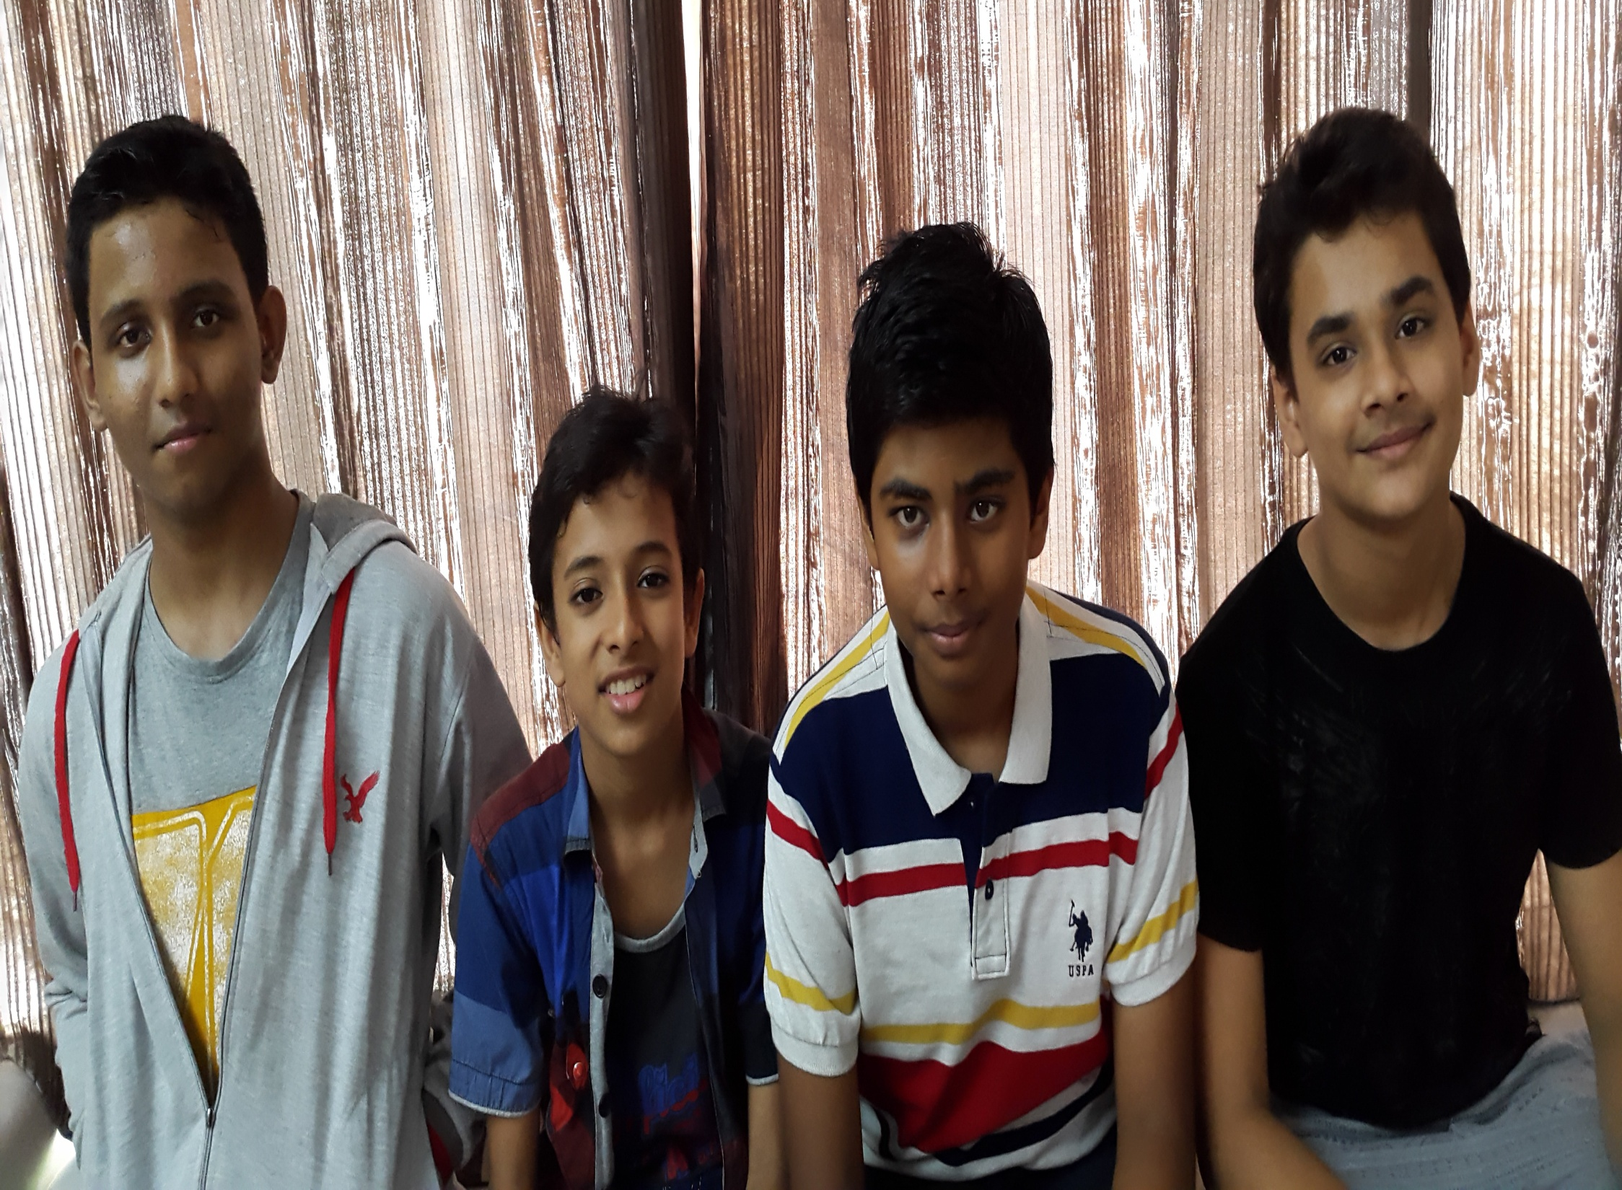
Eu -Mind
Made By -1.Divyansh Dalmiya
2.Vedant Ayare
3.Jay Jain
4.Vansh Shah

Slide 2
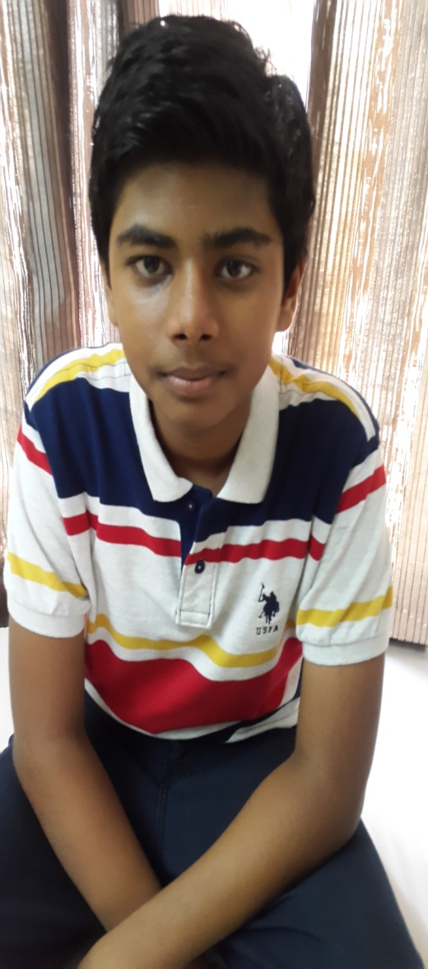
INTRODUCTION -PRESENT YOUR TEAM
Name-Divyansh Dalmiya
Age-14 years
Hobbies-To play football
Ambition-To be an IIT
Engineer . I am the group
leader

Slide 3
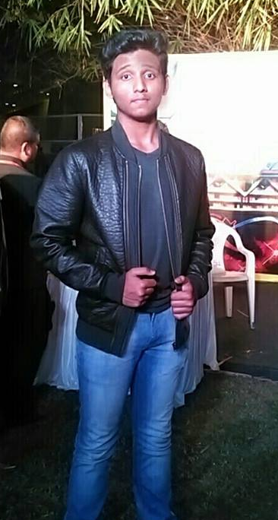
Name-Vedant Ayare
Age-15 Years
Hobbies-My hobby is to
read books.
Ambition-To be an
Aeronautical Engineer

Slide 4
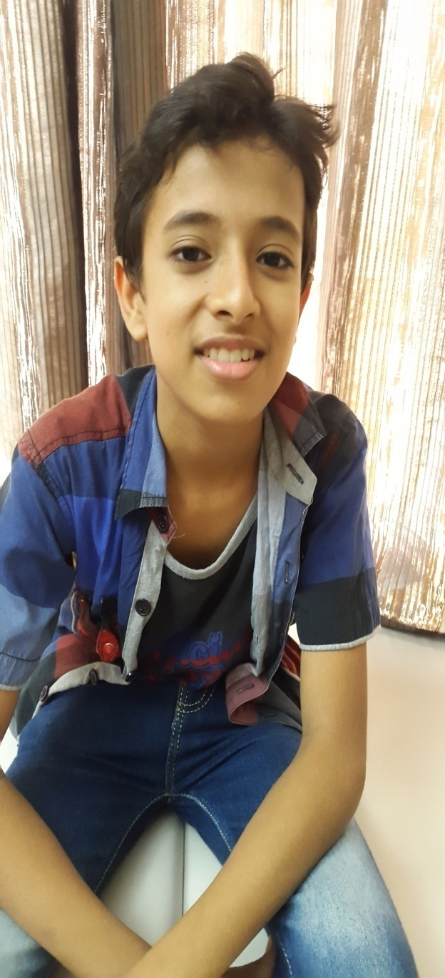
Name-Jay Jain
Age-13 Years
Hobbies-My hobby is
to Dance
Ambition-To become a
Computer Engineer

Slide 5
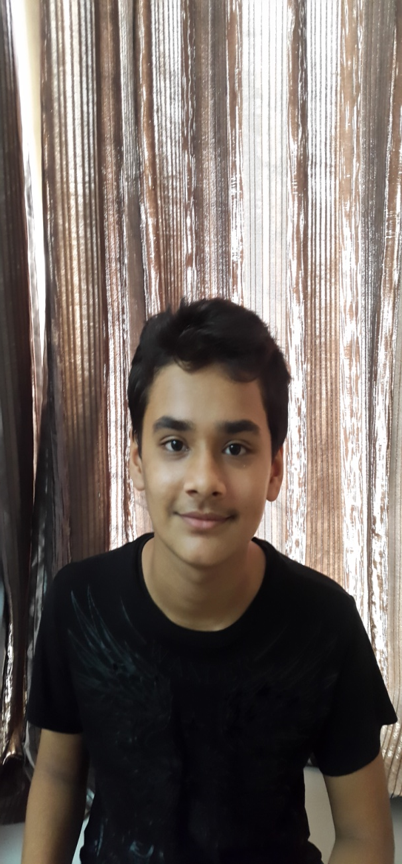
Name-Vansh Shah
Age-13 Years
Hobbies- Gadgets,
Gaming
Ambition- To become
an Automobile Engineer

Slide 6
Action Plan- Division of specific tasks
ROLE | WHO
GROUP LEADER | DIVYANSH DALMIYA
Editor WEEBLY | VedanT ayare
Photographer | Vansh shah
Video editor | Jay jain
questionariaes | Jay jain
interviews | Jay jain
Writing reports/summarizing answers | Vansh shah and divyansh dalmiya
Other tasks | Vedan ayare

Slide 7
Thank you

