Slide 1
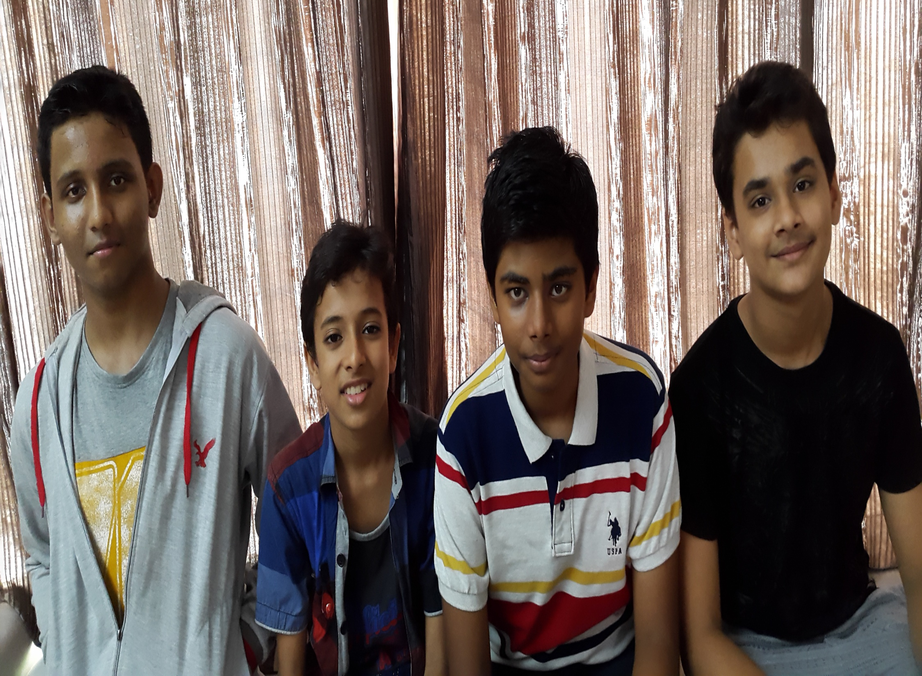
Eu -Mind

Slide 2
FAMILIES
Main Question: What Is The Importance Of The Role Of Families In India?
A]Families are very important in life.To prove this we have examples:
Grandparents: They are very much experienced in life and hence,help us in situation we know nothing about.
Parents: They help in a good upbringing of the child.
Brothers/Sisters: They act as a friend and are companions in our mischief but at times they are very much annoying.

Slide 3
OUTCOMES OF THE RESEARCH
We have come to know that now a days due to increase socialization families are not sharing their thoughts and talks.
Connect And Share

Slide 4
REASEARCH ACTIVITES
On 26/11/15 we have conducted an interview with some of the families and their opinion was that families should be experincing cultural activites like singing and drama and they should stay together and connected social networking websites

Slide 5
PEOPLE WHO HAVE BEEN INTERVIEWED
NAME AGE GENDER
SNEHA SHAH 65 F
RAHUL SHAH 75 M

Slide 6
Questionnaries-Jay Jain
When we interviewed some families I asked questions like how would they spend their day ? Etc.
1st question was how much time they spend sharing thoughts and talks among each other .
2nd question was that how frequently did they went on family trips .etc .
3rd question was that did they discuss their opinions in different situations and topics .

Slide 7
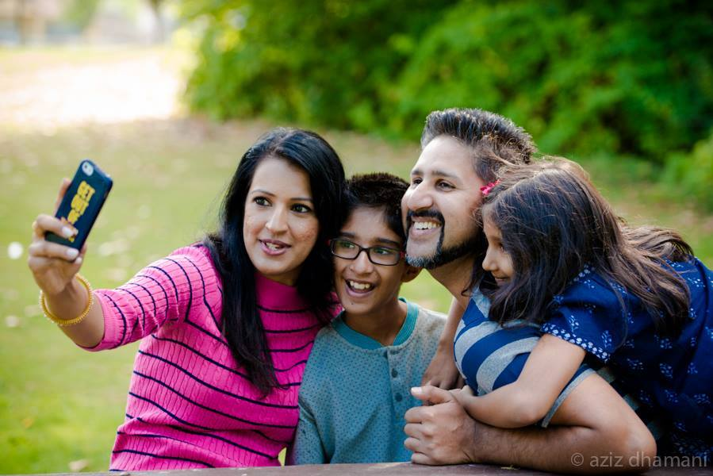
Interviews
The Shahs
We have interviewed five families they are as follows-
The Dalmia family
The Jain family
The Shah family
The Ayare family
The Chouhan family
The Jains

